Slide 1
Using Machine Learning To Predict Weather Changes
By: Ayodeji Abdulfatai Oyinloye – ClimateWins Trainee in Machine Learning
Date: 29.04.2025

Slide 2
Research Objective and Relevant Questions
The goals of machine learning application to the weather dataset:
How might machine learning be used to predict changes in weather conditions?
How might the procedure be used to accurately predict favorable or unfavorable weather conditions for a given day?
Research Questions
What are the inherent limitations in the dataset available for analysis?
What hypotheses can be employed to lead analysis to the desired solution?
Which particular techniques of the procedure will be suitable for the data at hand?

Slide 3
Data Source and Limitations
The dataset for this project was sourced from the European Climate Assessment and Dataset project (ECA&D) which was established in 1998
The dataset consists of 8 to 11 variables on weather conditions measured across 18 European weather stations (Dataset)
Data Limitation and Biases
Age of Data and Concern for Accuracy – dataset dates back to 1960 whereas ECA&D was established in 1998
Regional and Cultural Biases – there have to be procedures to ensure that conclusions from data from only 18 locations can be extrapolated to represent the entire continent
Human Bias in Existing Data – assurances need to be ascertained that data collection equipment and human actions present the same level of accuracy across the 60 + year period
Potential for Erroneous and Misleading Conclusions – extremes in weather conditions caused by global warming are more recent than the entire age of the dataset, opening up concern for validity of using the entire historical data for current purpose

Slide 4
Research Hypotheses
Hypothesis 1:
If accurate historical weather data is available then machine learning may be employed to predict future weather conditions
Hypothesis 2:
Accuracy of predictions will vary across locations based on the varied weather conditions and exact relevance of the variables in data to this purpose.
Hypothesis 3:
Algorithms can learn patterns in the weather dataset to predict values for future to varying levels of accuracy based on suitability for the dataset

Slide 5
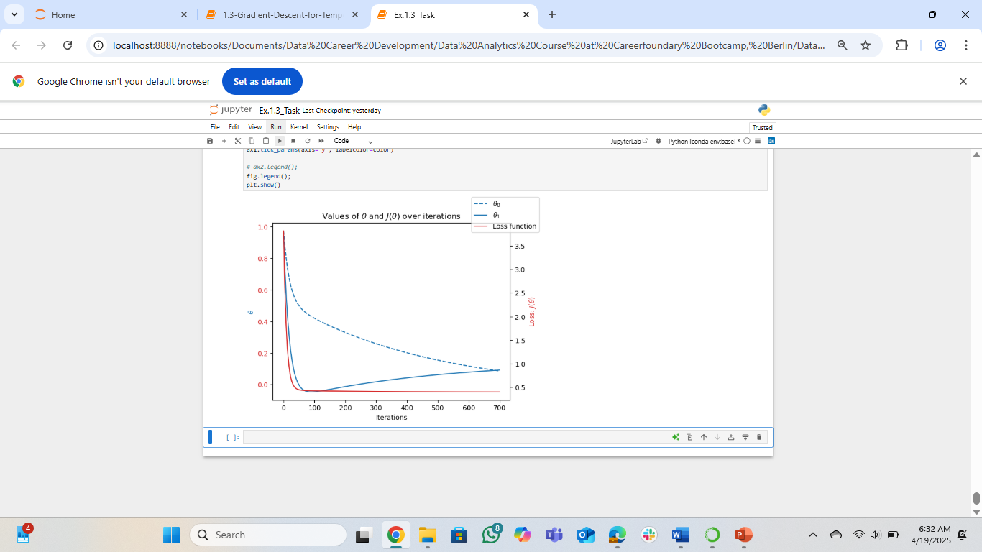
Optimization Technique
Gradient Descent
Optimization is a necessary technique done to understand the type(s) of relationship or patterns in the data so the task of predicting those relationships is feasible at an optimal efficiency of money (computing resources) and time costs
Gradient descent algorithm is a first-order type used to find the local minimums or maximums in the data landscape by taking the derivatives/slopes of the non-linear relationships in this dataset(slope has value zero at these points).
This aided the algorithm to converge near zero in loss function (distance to solution desired), using a combination of influences of the variables (weights) and approximating the solution by limiting errors from end to beginning in repeats/iterations (backpropagation)
The hyperparameter called learning rate/step size would be applied by me, when needed, to determine what difference the algorithm should make in the set of values of the learning parameters above between successive runs of iterations.
The figure to the right shows how the loss converged near zero for the variables for Dusseldorf weather station in the data values for year 2020.
θ₀ is a bias or offset that adjusts the baseline of the nonlinear function, and θ₁ is a weight that scales the influence of a specific feature or term. They are optimized to shape the nonlinear relationship between inputs and outputs, minimizing the prediction error

Slide 6
Optimization Parameters Values Used
Gradient Descent
Table to the left shows the set of parameters values involved for the three weather stations used as sample study for local data landscapes of the specified weather stations.
Weather Station | Year | Theta0 | Theta1 | Iterations | Step Size
Belgrade | 1980 | 0 | 0 | 950 | 0.01
Belgrade | 2000 | 0 | 0 | 950 | 0.01
Belgrade | 2020 | 0 | 0 | 550 | 0.01
Düsseldorf | 1980 | 0 | 0 | 360 | 0.01
Düsseldorf | 2000 | 0 | 0 | 500 | 0.01
Düsseldorf | 2020 | 0 | 0 | 700 | 0.01
Heathrow | 1980 | 0 | 0 | 350 | 0.01
Heathrow | 2000 | 0 | 0 | 450 | 0.01
Heathrow | 2020 | 0 | 0 | 950 | 0.01

Slide 7
Machine Learning Model – 1 (KNN)
SN | Weather Station | TP (True Positive) Count | FN (False Negative) Count | TP + FN | Accuracy: (TP/TP+FN)*100%
1 | BASEL | 5084 | 654 | 5,738 | 88.6 %
2 | BELGRADE | 4899 | 839 | 5.738 | 85.4%
3 | BUDAPEST | 4958 | 780 | 5,738 | 86.4%
4 | DEBILT | 5180 | 558 | 5,738 | 90.3%
5 | DUSSELDORF | 5146 | 592 | 5,738 | 90.0%
6 | HEATHROW | 5001 | 737 | 5,738 | 87.2%
7 | KASSEL | 5248 | 490 | 5,738 | 91.5%
8 | LJUBLJANA | 5017 | 721 | 5,738 | 87.4%
9 | MAASTRICHT | 5199 | 539 | 5,738 | 90.6%
10 | MADRID | 5007 | 731 | 5,738 | 87.3%
11 | MUNCHENB | 5118 | 620 | 5,738 | 89.2%
12 | OSLO | 5195 | 543 | 5,738 | 90.5%
13 | SOONBLICK | Incomplete coding of y dataset |  | 5,738
14 | STOCKHOLM | 5121 | 617 | 5,738 | 89.2%
15 | VALENTIA | 5525 | 213 | 5,738 | 96.3%
 | Average accuracy of prediction |  |  |  | 89.3
Because the relationship between the variables in the dataset is nonlinear, it is only a classification model (and not regression) that can be used for predicting weather conditions in this supervised learning study.
The first model considered used the classification algorithm K-nearest neighbor (KNN), working by calculating respective distances between neighboring datapoints to determine the class/group each belongs.
A parameter, k, determines the number of layers of neighbors the algorithm considered (this model used 1st to 3rd, that is k = 1,2, and 3)
For the training scenario: training and testing accuracies were respectively 57% and 45%
The average prediction accuracy across the weather stations, for true instances of pleasant and unpleasant daily weather, was 89.3% for this model.
Table to the right shows station specific situations.
The data was scaled to remove varying effects of individual scales of measure and ensure no particular variable magnitude dominate and bias the model

Slide 8
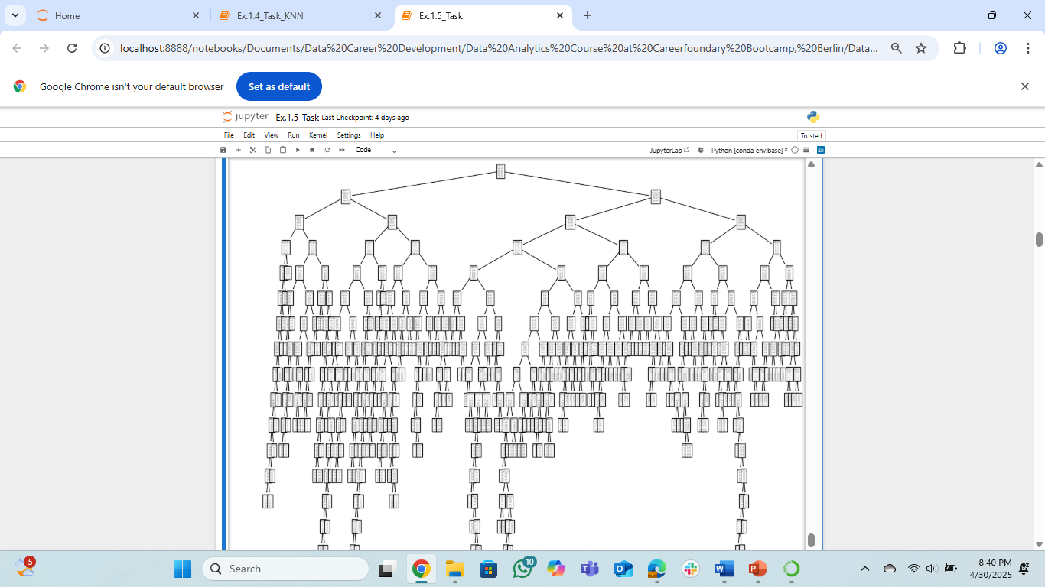
Machine Learning Model – 2 (DT)
The next algorithm tried on the dataset was the Decision Tree (DT). It mimics the way humans reason by using line of ‘yes or no’ answers to logically reach the answer to a question or solution to a problem.
It actually resembles a real tree in that the starting question is the root of the ‘tree’, the forking series of ‘yes/no’ represent the branches while the logical termination point of each branch is a leaf or leaf node
In the parameters used for this study, limits were not set as to the precise number of decision nodes (branches) and leaf nodes, the tree has grown to incorporate some stretch not particularly relevant to the main solution desired – pruning is required.
For the training scenario: training and testing accuracies were respectively 59.2% and 61.9%
The average prediction accuracy across the weather stations, for true instances of pleasant and unpleasant daily weather, was 94.1% for this model.
Figure to the right shows the output.
The data was scaled to remove varying effects of individual scales of measure and ensure no particular variable magnitude dominate and bias the model

Slide 9
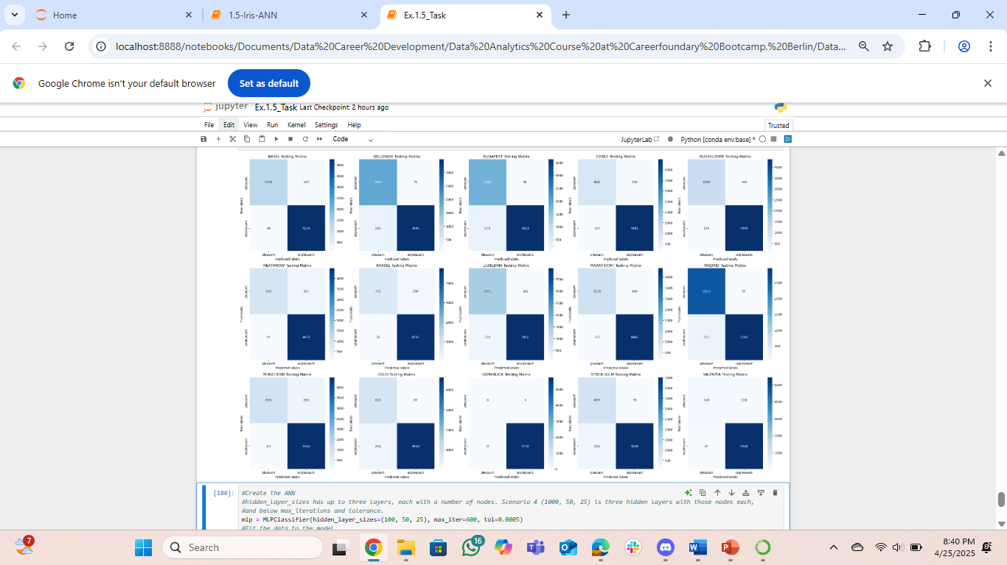
Machine Learning Model – 3 (ANN)
The third classification algorithm tried on the dataset was the Artificial Neural Network (ANN). It is a powerful algorithm in converging on machine learning solution.
It can combine a maximum of 3 hidden layers (> 3 is AI configuration), nodes within these layers and options of iterations and tolerance to converge on a solution.
Several scenarios of these combinations were tried and the optimal scenario is the third as shown in figure to the left (bottom)
For the optimal scenario: training and testing accuracies were respectively 66.7% and 58.3%
The average prediction accuracy across the weather stations, for true instances of pleasant and unpleasant daily weather, was 94.5% for this model.
Figure to the right (top) shows the confusion matrix for the optimal scenario.
The data was scaled to remove varying effects of individual scales of measure and ensure no particular variable magnitude dominate and bias the model
SN | Scenario | ANN specification | y_pred_test (%) | y_test (%)
1 | 1 | 2 hidden layers (10, 10 nodes), max_iterations of 500 and tolerance of 0.0001 | 49.40 | 49.90
2 | 2 | 2 hidden layers (20, 20 nodes), max_iterations of 400 and tolerance of 0.0001 | 57.26 | 55.72
3 | 3 | 3 hidden layers (100, 50, 25 nodes), max_iterations of 400 and tolerance of 0.0002 | 66.65 | 58.29
4 | 4 | 3 hidden layers (100, 50, 25 nodes), max_iterations of 600 and tolerance of 0.0005 | 65.37 | 58.02

Slide 10
Summary and Next Steps
Hypotheses:
If accurate historical weather data is available, then machine learning may be employed to predict future weather conditions
Accuracy of predictions will vary across locations based on the varied weather conditions and exact relevance of the variables in data to this purpose.
Algorithms can learn patterns in the weather dataset to predict values for future to varying levels of accuracy based on suitability for the dataset
Next Steps:
Further application of unsupervised learning algorithm to the dataset (we cannot conclude yet that the option of supervised learning is the best)
Limit the predictor variables (independent) to optimal selection for better results
Determine how models can be used to predict specific extreme weather conditions
Determine how results for 18 cities can be extrapolated for entire continental Europe.
SN | Accuracy Description | Accuracy Rating for KNN and Affected Weather Station (%) | Accuracy Rating for DT and Affected Weather Station (%) | Accuracy Rating for ANN and Affected Weather Station (%)
1 | Highest rating | VALENTIA: 96.3 | DUSSELDORF: 99.3 | VALENTIA: 97.2
2 | Lowest rating | BELGRADE: 85.4 | STOCKHOLM: 88.8 | HEATHROW: 93.0
3 | Average across all stations | 89.3 | 94.1 | 94.5

Slide 11

The End!
Contact: ayooyin2003@yahoo.com ; LinkedIn
My GitHub page for this project is: ay104/ClimateWins_repo: Machine Learning Weather Prediction by ClimateWins
Thank You!

